Slide 1
MSA 8770 Text Analytics Mini-Project 1 Shreyashi Mukhopadhyay September 26, 2023

Slide 2
Word frequency distribution Analysis

Slide 3
Assignment
What words or phrases appear more frequently in questions that students do well on?
Given a dataset about some quiz questions of a hypothetical EdTech startup in a Json format, analyze the following:
What words or phrases appear more frequently in questions that students tend to do poorly on?
The percent of students who have answered the question correctly.

Slide 4
Data Description
Data Contains 10191 rows with 2 columns and Zero Null Values
# | Column | Non-Null Count | Dtype
0 | text | 10191 non-null | object
1 | percent_correct | 10191 non-null | float64
Index | text | percent_correct
0 | Which statement BEST supports Obama's goal for... | 0.655172
1 | Read the sentence from the passage. ... | 0.568966
2 | What can we conclude Obama hoped to gain by in... | 0.655172
3 | Read this sentence from the passage. ... | 0.586207
4 | Which of the following claims made by Presiden... | 0.413793

Slide 5
Descriptive Statistics
Measure | percent_correct
count | 10191
mean | 0.57656
std | 0.161973
min | 0
0.25 | 0.464065
0.5 | 0.581982
0.75 | 0.697275
max | 1

Slide 6
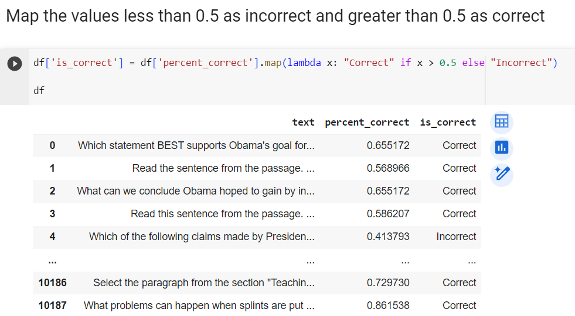
Data Preprocessing

Slide 7
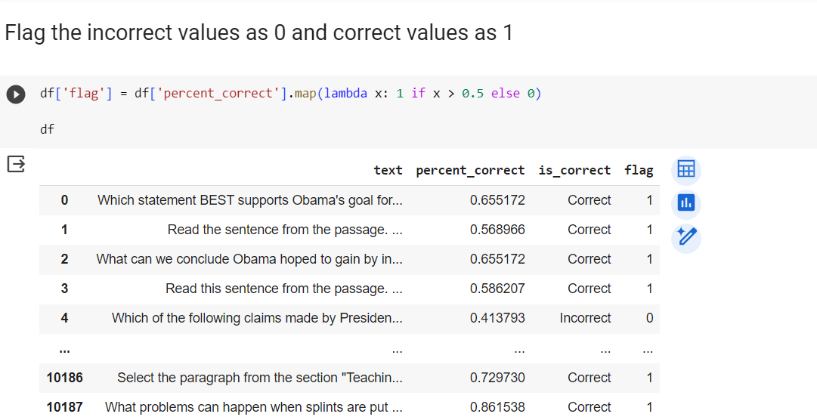
Data Preprocessing

Slide 8
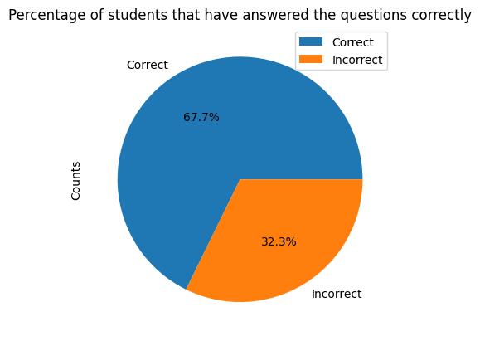
Distribution of correct and Incorrect answers
index | Is_correct | Counts
0 | Correct | 6903
1 | Incorrect | 3288

Slide 9
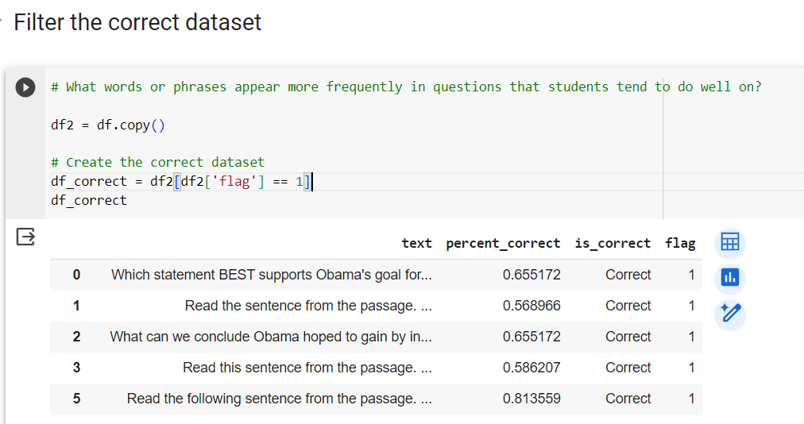
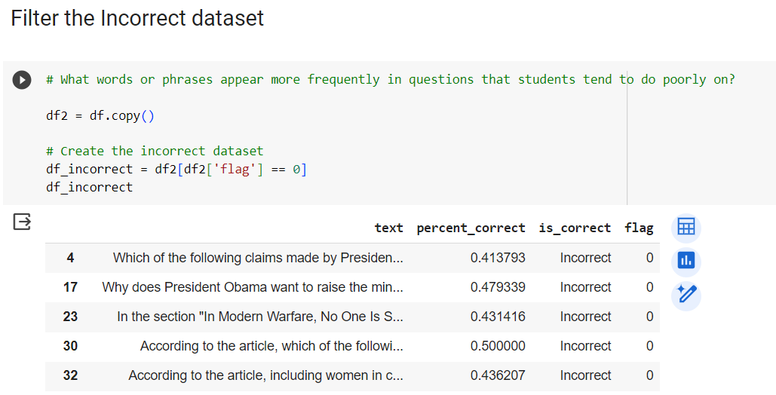
Filter & create the correct and incorrect datasets

Slide 10
Approach 1: Word Cloud

Slide 11
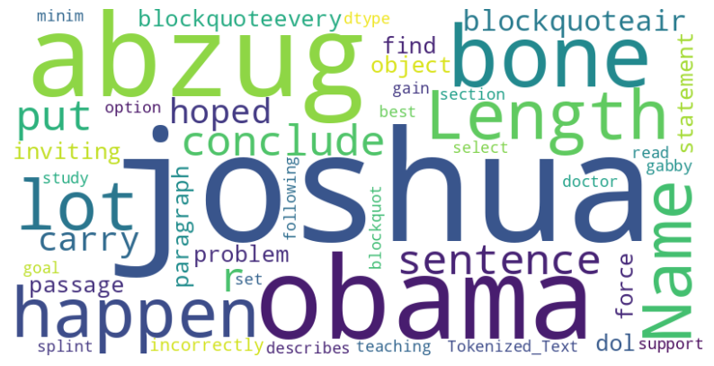
Word cloud for correct responses
The words most frequently occurring in the word cloud for the correct responses data include Joshua, abzug, Obama, Length, Length, Name, Happen, Bone, lot, carry, sentence, conclude, hoped, put etc.

Slide 12
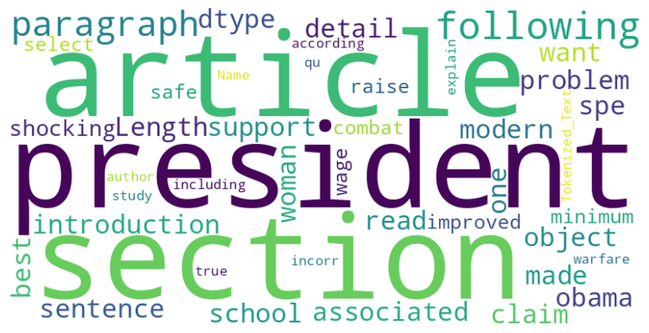
Word cloud for incorrect responses
The words most frequently occurring in the word cloud for the correct responses data include Article, president, section, paragraph, following, introduction, detail, shocking, length, Obama, support etc.

Slide 13
Conclusion:
Both the correct and incorrect data word clouds have a strong mention about President Obama.
The correct response word cloud specifically highlights the word Joshua Abzug who seems to be an orthopedic doctor due to the presence of the words bone, length and hopeful.
The incorrect response word cloud highlights the words President, articles, section and paragraph, women, wage which points towards questions based on social, law and legal matters.

Slide 14
Approach 2: Visualizing the top Unigrams, Bigrams and Trigrams word frequency distribution

Slide 15
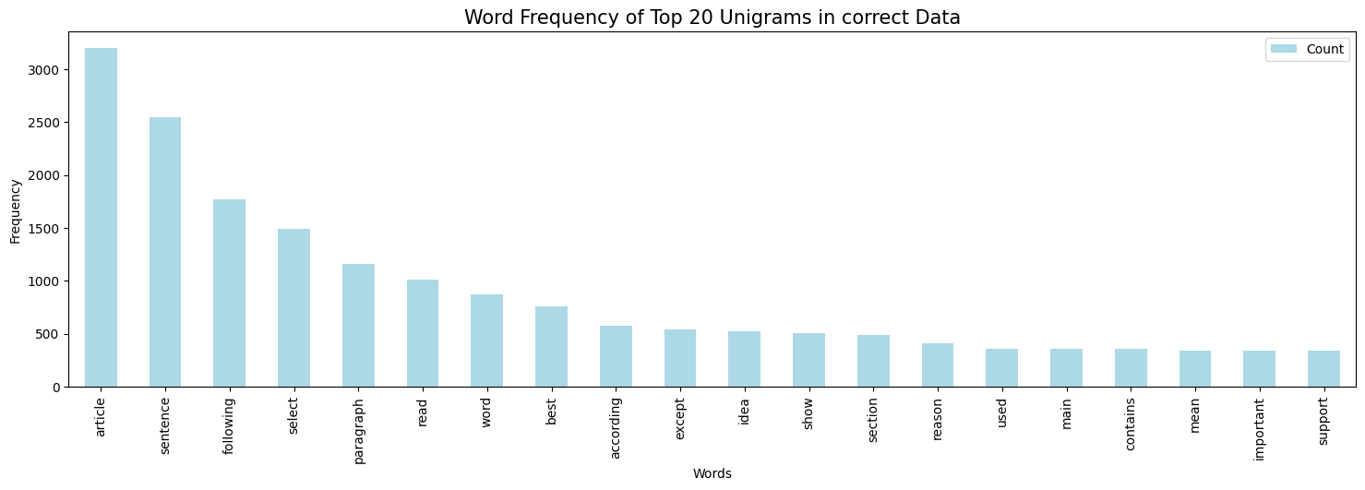
Unigram frequency for correct responses

Slide 16
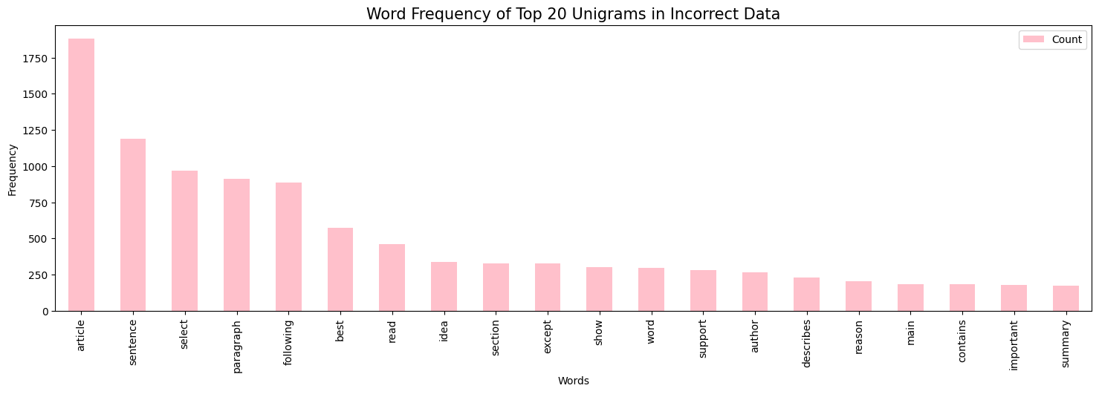
Unigram frequency for incorrect responses

Slide 17
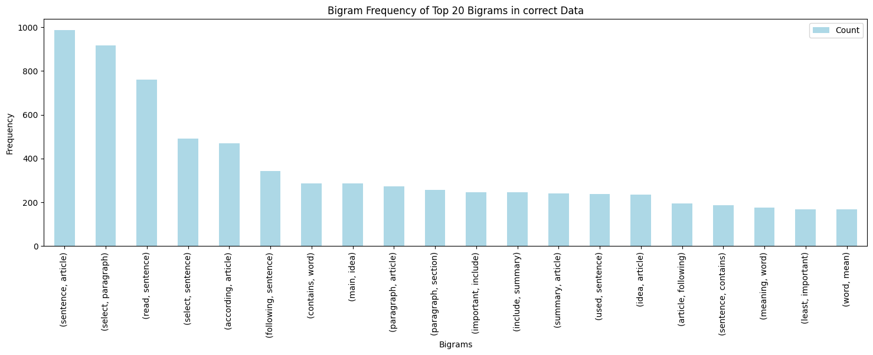
Bigram frequency for correct responses

Slide 18
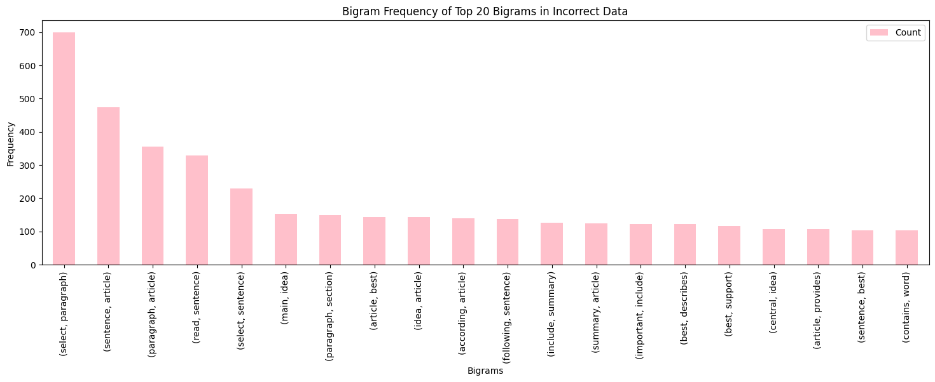
Bigram frequency for incorrect responses

Slide 19
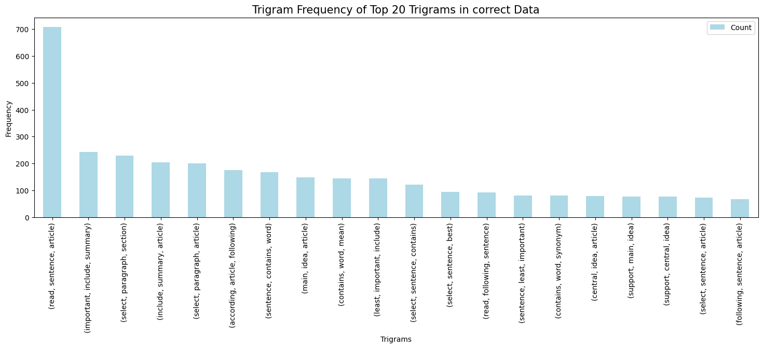
Trigram frequency for correct responses

Slide 20
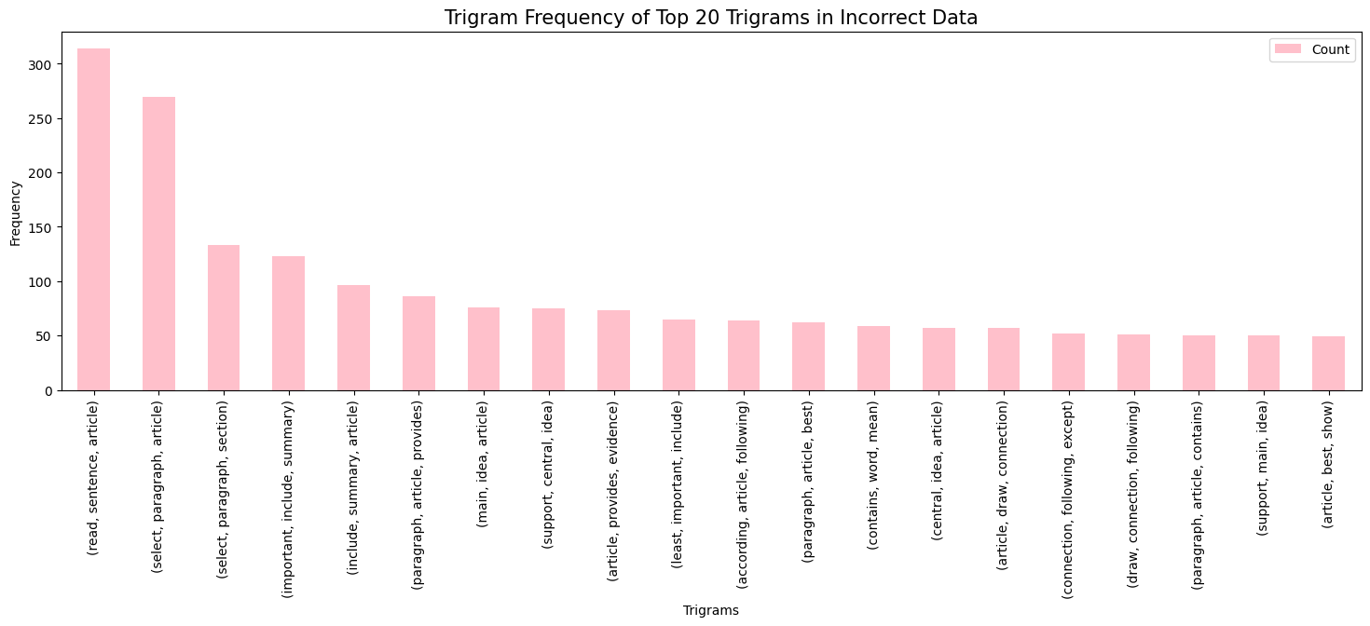
Trigram frequency for incorrect responses

Slide 21
Conclusion:
The unigram, bigram and trigram word frequency distribution visualization does not indicate very different words as having high frequency in the corpus. The high frequency words in all three cases are similar with a little variation.
This approach did not prove to be very informative as the previous approach.

Slide 22
Approach 3: Visualizing the topics using BERT Topic Models

Slide 23
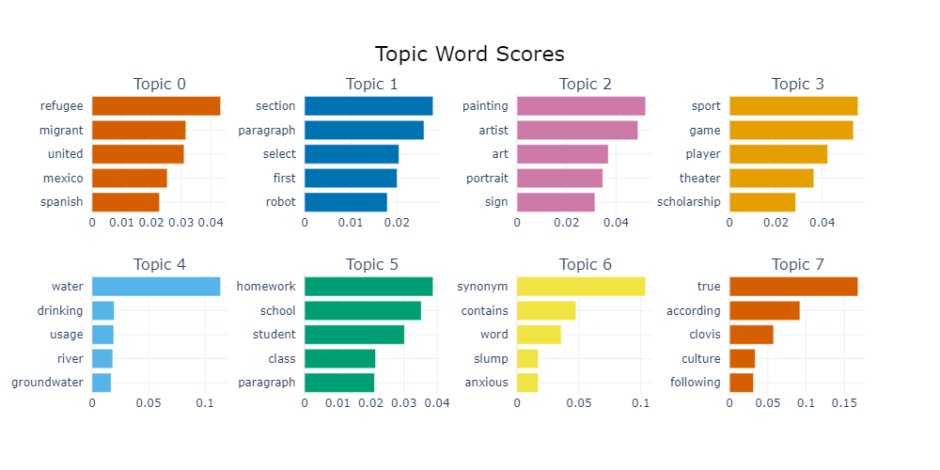
Topics prominent in correct responses data
The prominent topics in the correct responses data constitute of subjects like Immigration, robots, paintings and art, sports, water, schooling, English language and culture.

Slide 24
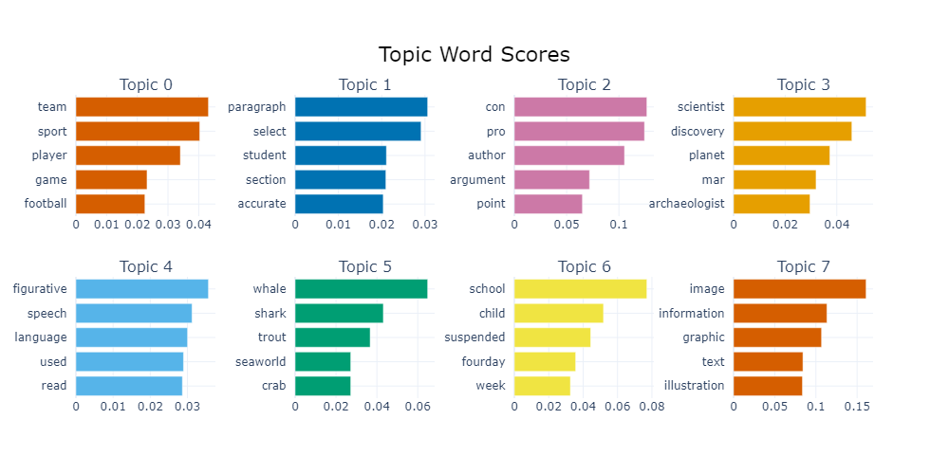
Topics prominent in incorrect response data
The prominent topics in the correct responses data constitute of subjects of sports, English language, debates, science and space, sea animals,
Schooling and Computer graphics.

Slide 25
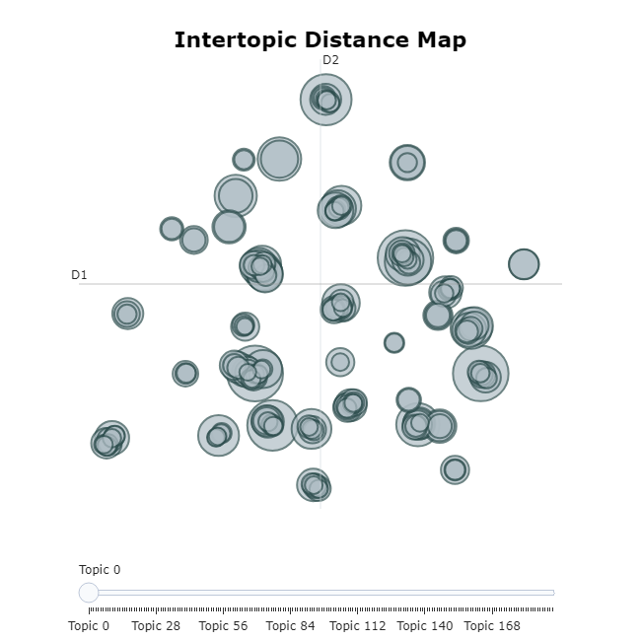
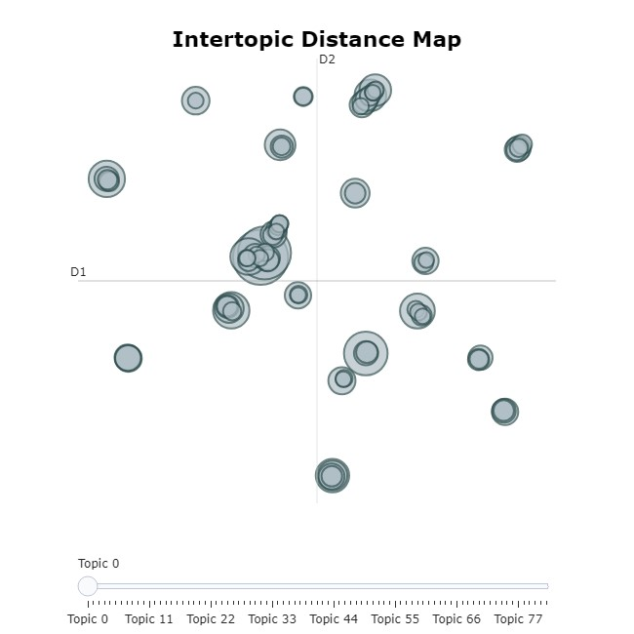
Intertopic distance map comparison
The intertopic distance in the Correct responses data is comparatively less and shows topic clusters which are closer to each other indicating similar questions being asked than the Incorrect responses data where the topic clusters are more distant and hence show a variation in the topics of the questions asked and hence the incorrect responses and poor performance on these questions has been observed.
Correct responses data
Incorrect responses data

Slide 26
Conclusion:
All the three approaches namely:
Word Cloud Plots
Unigram, Bigram and Trigram frequency distribution Plots
BERT topic modelling Plots
Have been very insightful in finding the prominent themes and clustering patterns in the questions asked to the students. The topics of the questions do not appear to be very different between the two groups, but the Intratopic distance map indicates a lot of variation in the topics of the questions within the Incorrect response group compared to the correct answer response group which can be considered as a potential reason why the students performed poorly in the incorrect response group.

Slide 27

Questions?

Slide 28
Thank you!

